Slide 1

TRAINING AND EVALUATING MACHINE LEARNING ALGORITHM FOR CLASSIFICATION OF MICROPLASTIC USING RAMAN SPECTROSCOPY

Slide 2

Aim
Introduction: Microplastics and Raman Spectroscopy
Contribution of Machine Learning
Datasets
Methods Used
Machine Algorithm Used
Conclusion
Future Work
﻿

Slide 3
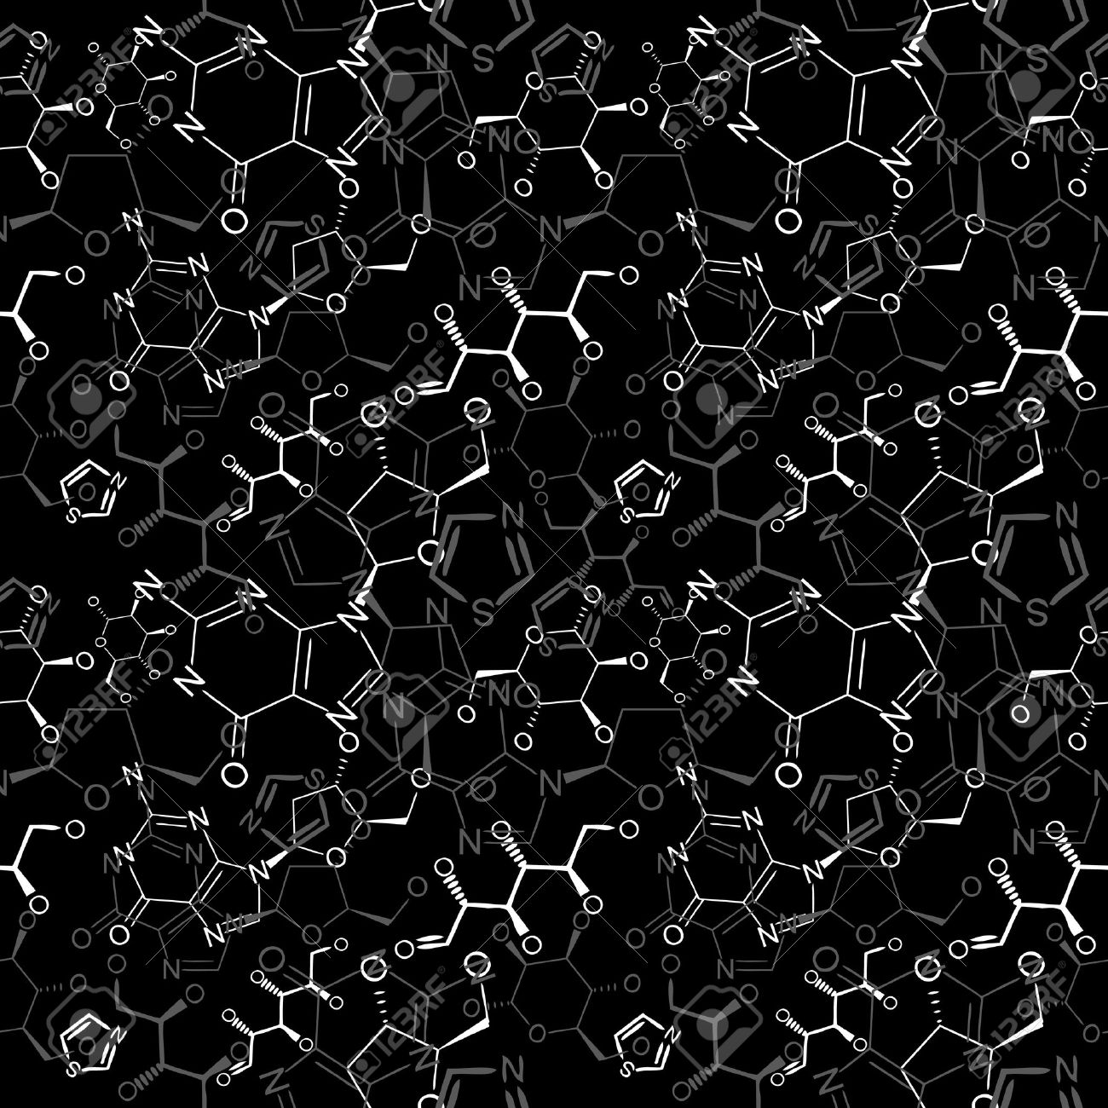
AIM
The primary objective of this study is to identify and characterize microplastics based on their Raman shift and intensity profiles.
By employing Raman spectroscopy, we aim to analyze the unique spectral fingerprints of various microplastic particles and establish a correlation between their Raman shifts and intensities.

Slide 4
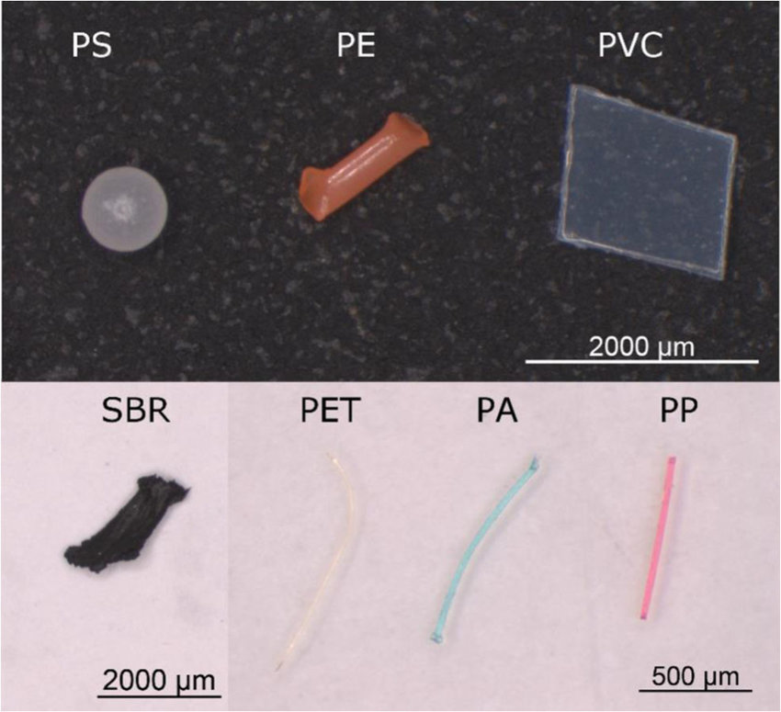
What are Microplastics?
Microplastics are small plastic particles, typically measuring less than 5 millimeters in size.
They are formed through the breakdown of larger plastic items such as bottles, bags, and packaging materials.
These tiny plastic particles pose a significant threat to our environment and wildlife as they can accumulate in waterways and oceans, potentially harming marine life and entering the food chain.
As it is a major threat it needs to be identified for which we have several techniques.

Slide 5
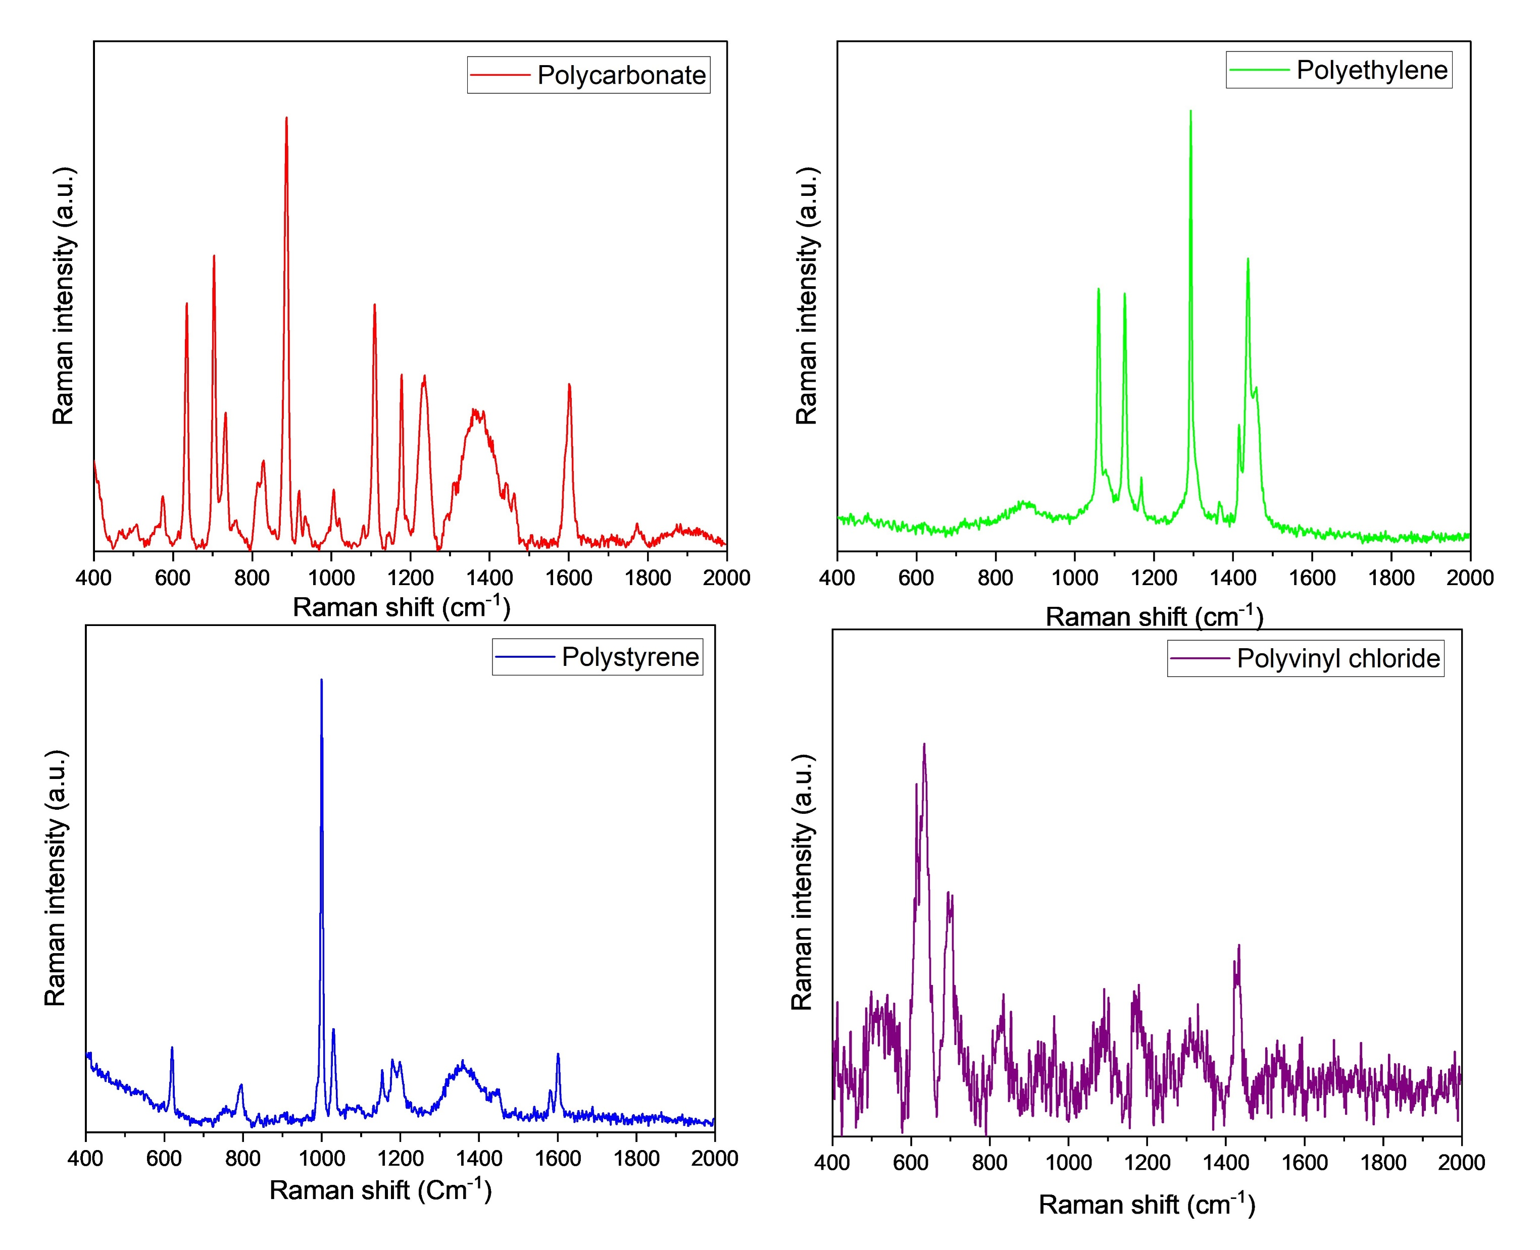
Raman Spectroscopy
The principle behind Raman spectroscopy is that the monochromatic radiation is passed through the sample such that the radiation may get reflected, absorbed, or scattered. The scattered photons have a different frequency from the incident photon as the vibration and rotational property vary.
The difference between the incident photon and the scattered photon is known as the Raman shift.
Intensity is the quantity of energy the wave conveys per unit time across a surface of unit area

Slide 6
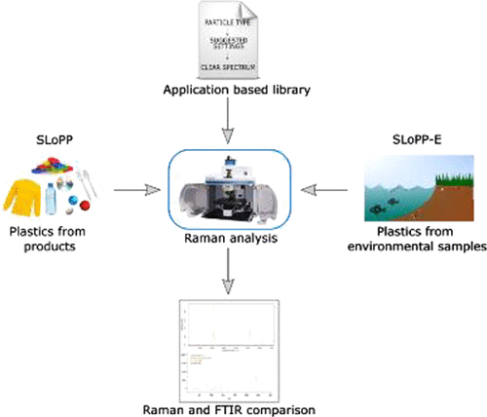
Dataset
We are collecting Raman spectra dataset from some predefined Database of SLOPP spectral libraries of plastic particles encompasses roughly 148 spectral references that specifically relate to plastics.
The second dataset called SLOPP -E spectral library of plastic particles aged in the environment contains 113 spectral data point.
We employ a combination approach involving our internal Raman Research laboratory (RaRe Lab)and leveraging the “bw tek portable Raman spectrometer” alongside the aforementioned SLOPP dataset we have achieved successful identification results for specific components furthermore descriptive tags have been incorporated to facilitate future applicability in our modeling and coding endeavors

Slide 7
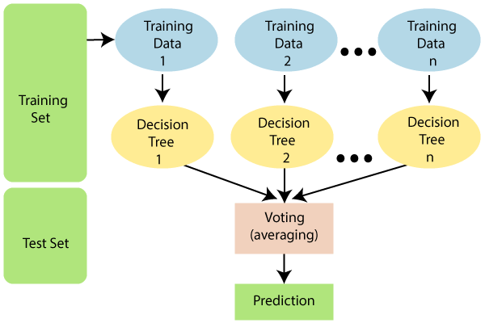
Random Forest (RF) Algorithm
The Random Forest (RF) algorithm is a powerful tool for microplastic identification. It is a machine learning algorithm that uses decision trees to classify data.
The algorithm works by creating multiple decision trees and combining their results to make a final decision.
This approach helps to reduce the risk of overfitting, which is when a model is too complex and performs well on the training data but poorly on new data.
In the context of microplastic identification, the RF algorithm can be used to classify different types of microplastics based on their Raman spectra with higher accuracy.

Slide 8
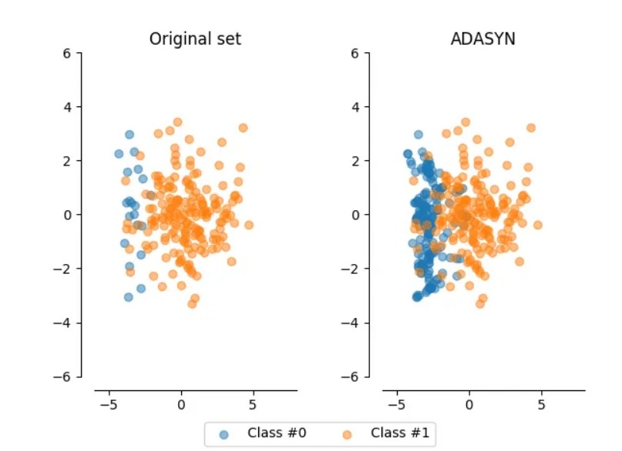
Handling Class Imbalance
Class imbalance is a common problem in classification tasks where one class has significantly fewer samples than the other classes. This can lead to biased models that perform poorly on the minority class. In this section, we will discuss techniques for handling class imbalance in our Random Forest Classifier model.
Oversampling
Oversampling involves increasing the number of samples in the minority class to balance the class distribution. This can be done using techniques like SMOTE or ADASYN. However, oversampling can also result in overfitting
Class Weighting
Class weighting involves assigning higher weights to the minority class during model training.. However, class weighting may not be effective for highly imbalanced datasets and may require tuning of the weight values.
Adaptive Synthetic Sampling (ADASYN) is a technique used to address imbalanced datasets in machine learning, improving classification performance for underrepresented classes.

Slide 9
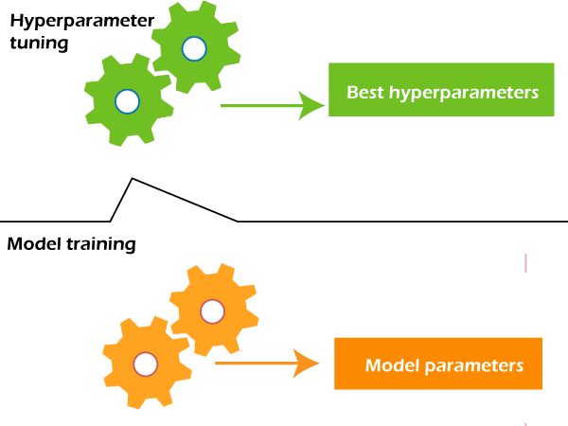
Hyperparameter Tuning
Hyperparameters are parameters that are not learned by the model during training, but are set prior to training. They can have a significant impact on the performance of the model. In this example, we will use scikit-learn's GridSearchCV function to perform a grid search over a range of hyperparameters for our Random Forest Classifier.
Grid Search
Grid search is a technique for finding the optimal combination of hyperparameters by exhaustively searching over a specified parameter space. In scikit-learn, we can perform a grid search using the GridSearchCV function.
hyperparameters directly control model structure, function, and performance. Hyperparameter tuning allows data scientists to tweak model performance for optimal results. This process is an essential part of machine learning, and choosing appropriate hyperparameter values is crucial for success.

Slide 10


LOAD RAMAN SPECTRA DATA
Data from RaRe lab and SLOPP database
FEAUTURE SELECTION
Selecting essential feature like RamanShift and Intensity
NORMALIZING USING STANDARD SCALE
resize the distribution of values
BALANCING DATA USING ADASYN
To consider both majority and minority classes
TESTING DATA
Splitting Data
TRAINIG DATA
HYPERPARAMETER TUNING
to tweak model performance for optimal results
PREDICTION USING BEST ESTIMATOR
Choosing the best prediction among rest
Accuracy, precision, recall, F1 scores, aare key to understanding classifier performance
PERFORMANCE AND EVALUVATION
Flowchart of the Model
Identification of element based on prediction
RESULT

Slide 11
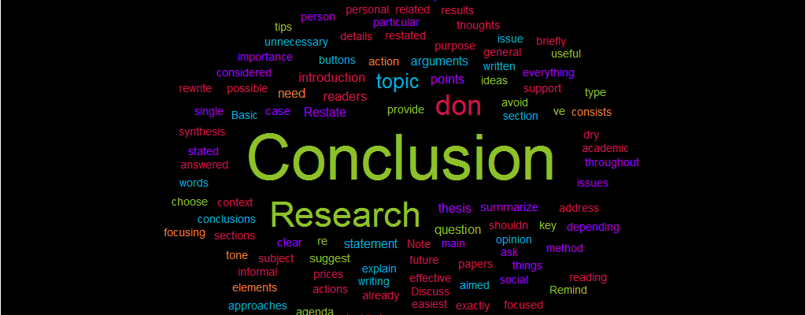
Conclusion
This research shows how to train a Random Forest Classifier for a classification problem.
Additionally, we've demonstrated methods to address class imbalance and optimize hyperparameters for enhanced model efficacy.
By using these methods, we can increase the accuracy and precision of our classification tasks.
It's worth mentioning that these methods can be utilized not only with Random Forest Classifier but with other classification algorithms as well.
We trust that this example has been useful in comprehending the classification model training process and the significance of managing class imbalance and hyperparameter adjustment.

Slide 12
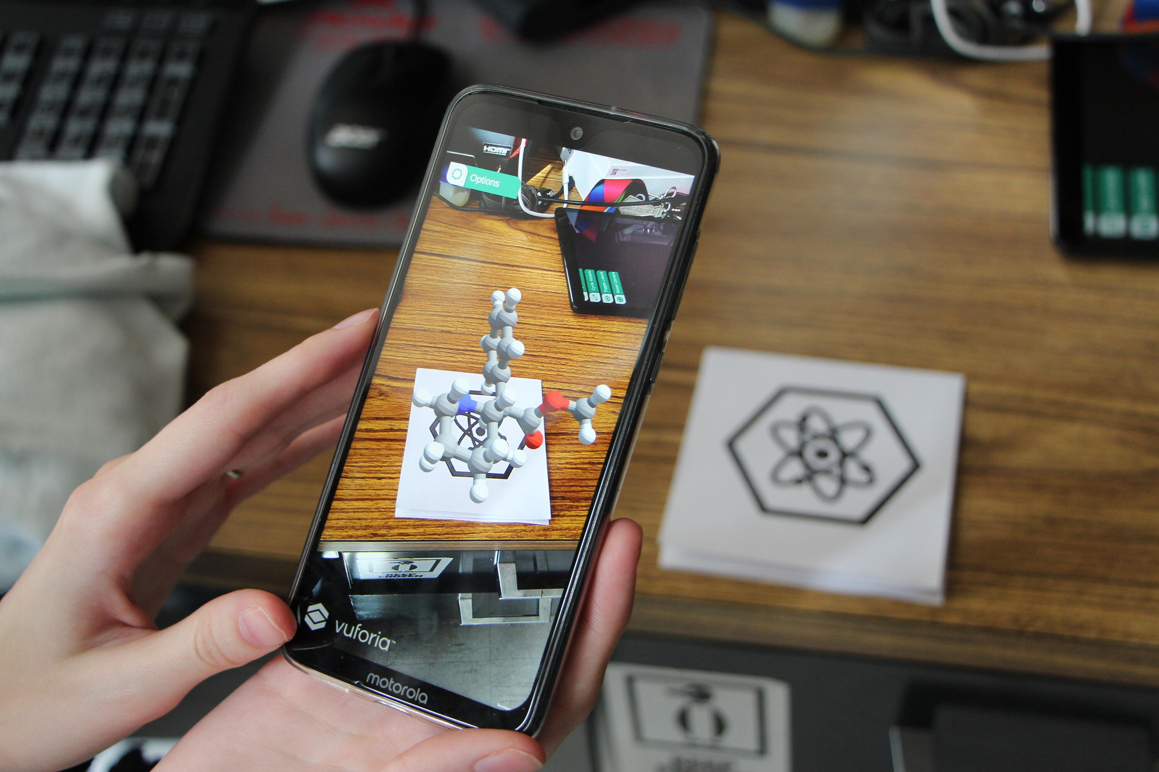
Future work
If people using this code are not from field of computer science or if they don't have any knowledge about coding it is hard for them to handle and identify output from the code.
So we can hide the implementation by creating some software or app where people can easily identify the name of given sample without any contact with coding part.
Anyone can identify type of plastic with their handy device

Slide 13

Acknowledgement
Dr. RajaPandiyan JP, Raman Research Laboratories, Department of Chemistry, SRM University AP, Andhrapradesh
Ms.JayaSree Kumar , Raman Research Laboratories, Phd chemistry, SRM University AP, Andhrapradesh
Faculty and colleagues –Department of Chemistry,SRM AP
Faculty and colleagues –Department of Chemistry,SRM AP

